Slide 1
THG Simulations
Project update
Week 8
05/09/2023
David Amorim

Slide 2
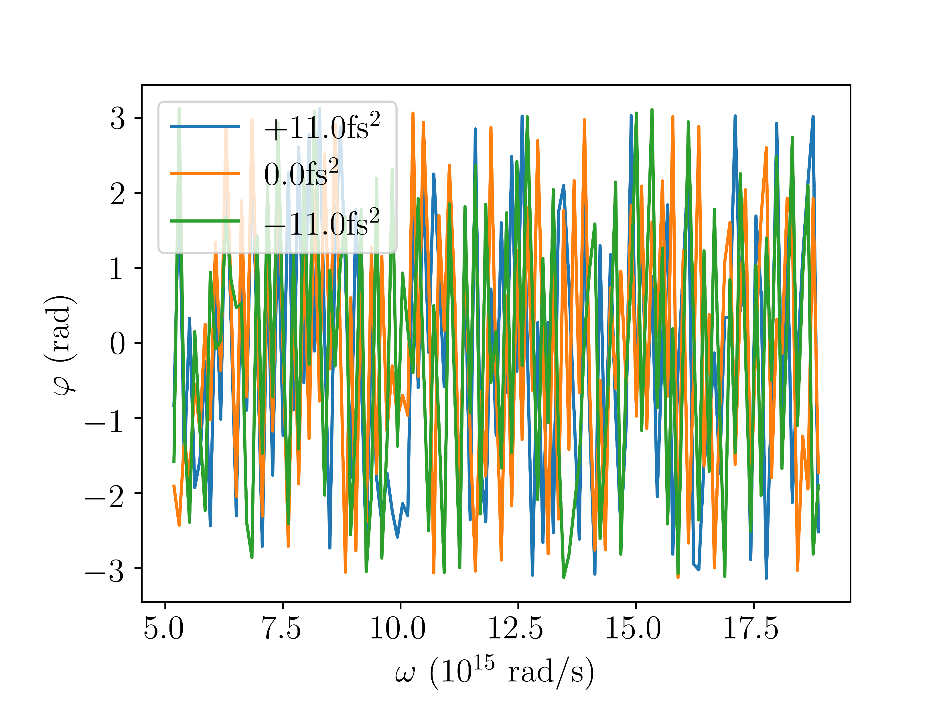
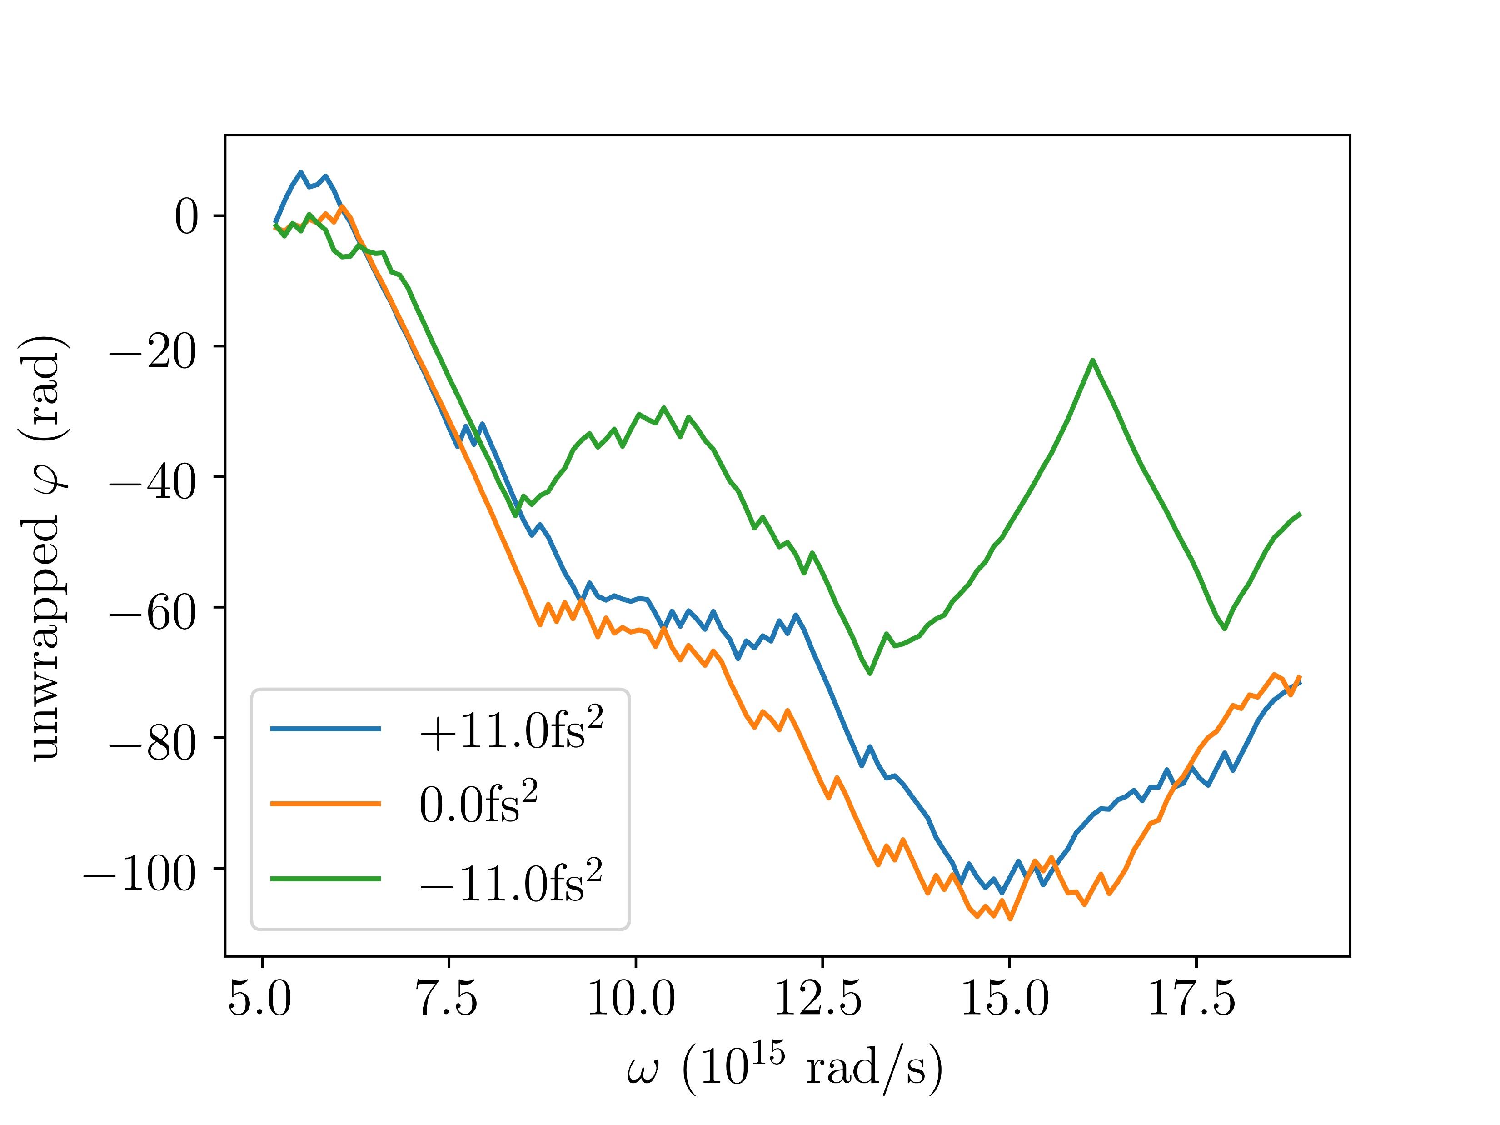
Spectral phase UV
Argon; 0.4bar (rescaled); 150mW

Slide 3
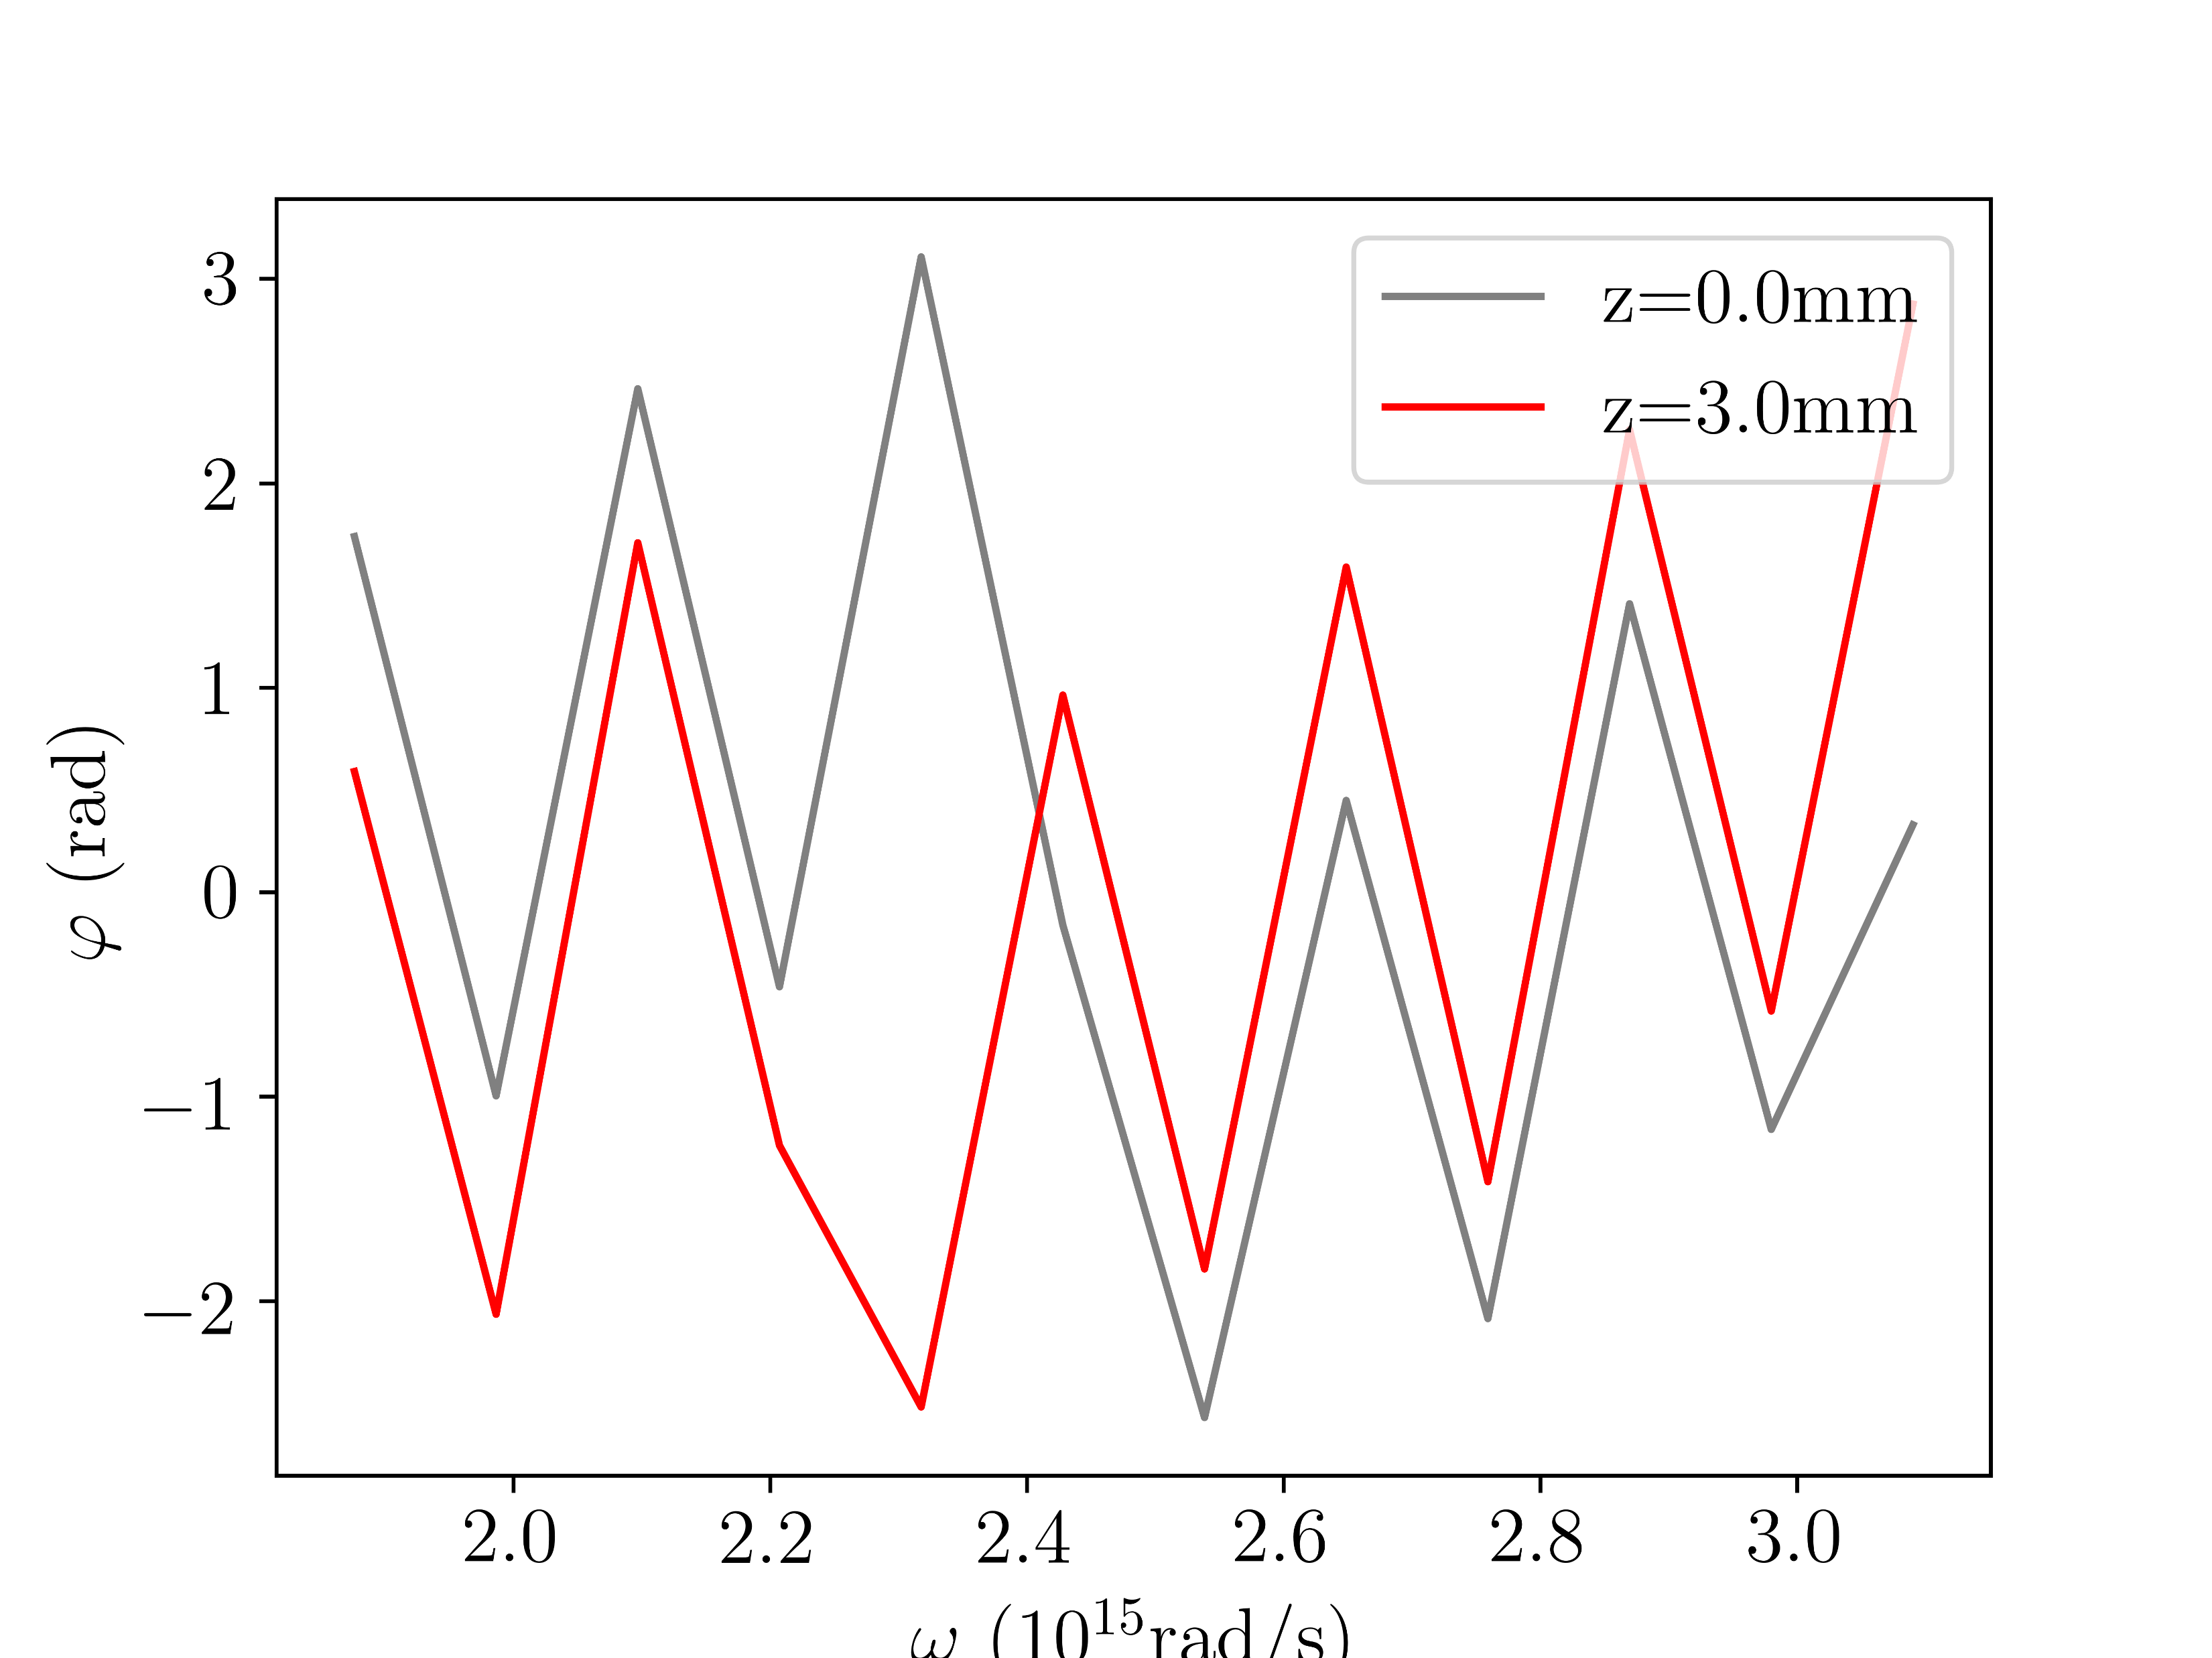
Spectral phase IR
Argon; 0.4bar (rescaled); 150mW

Slide 4
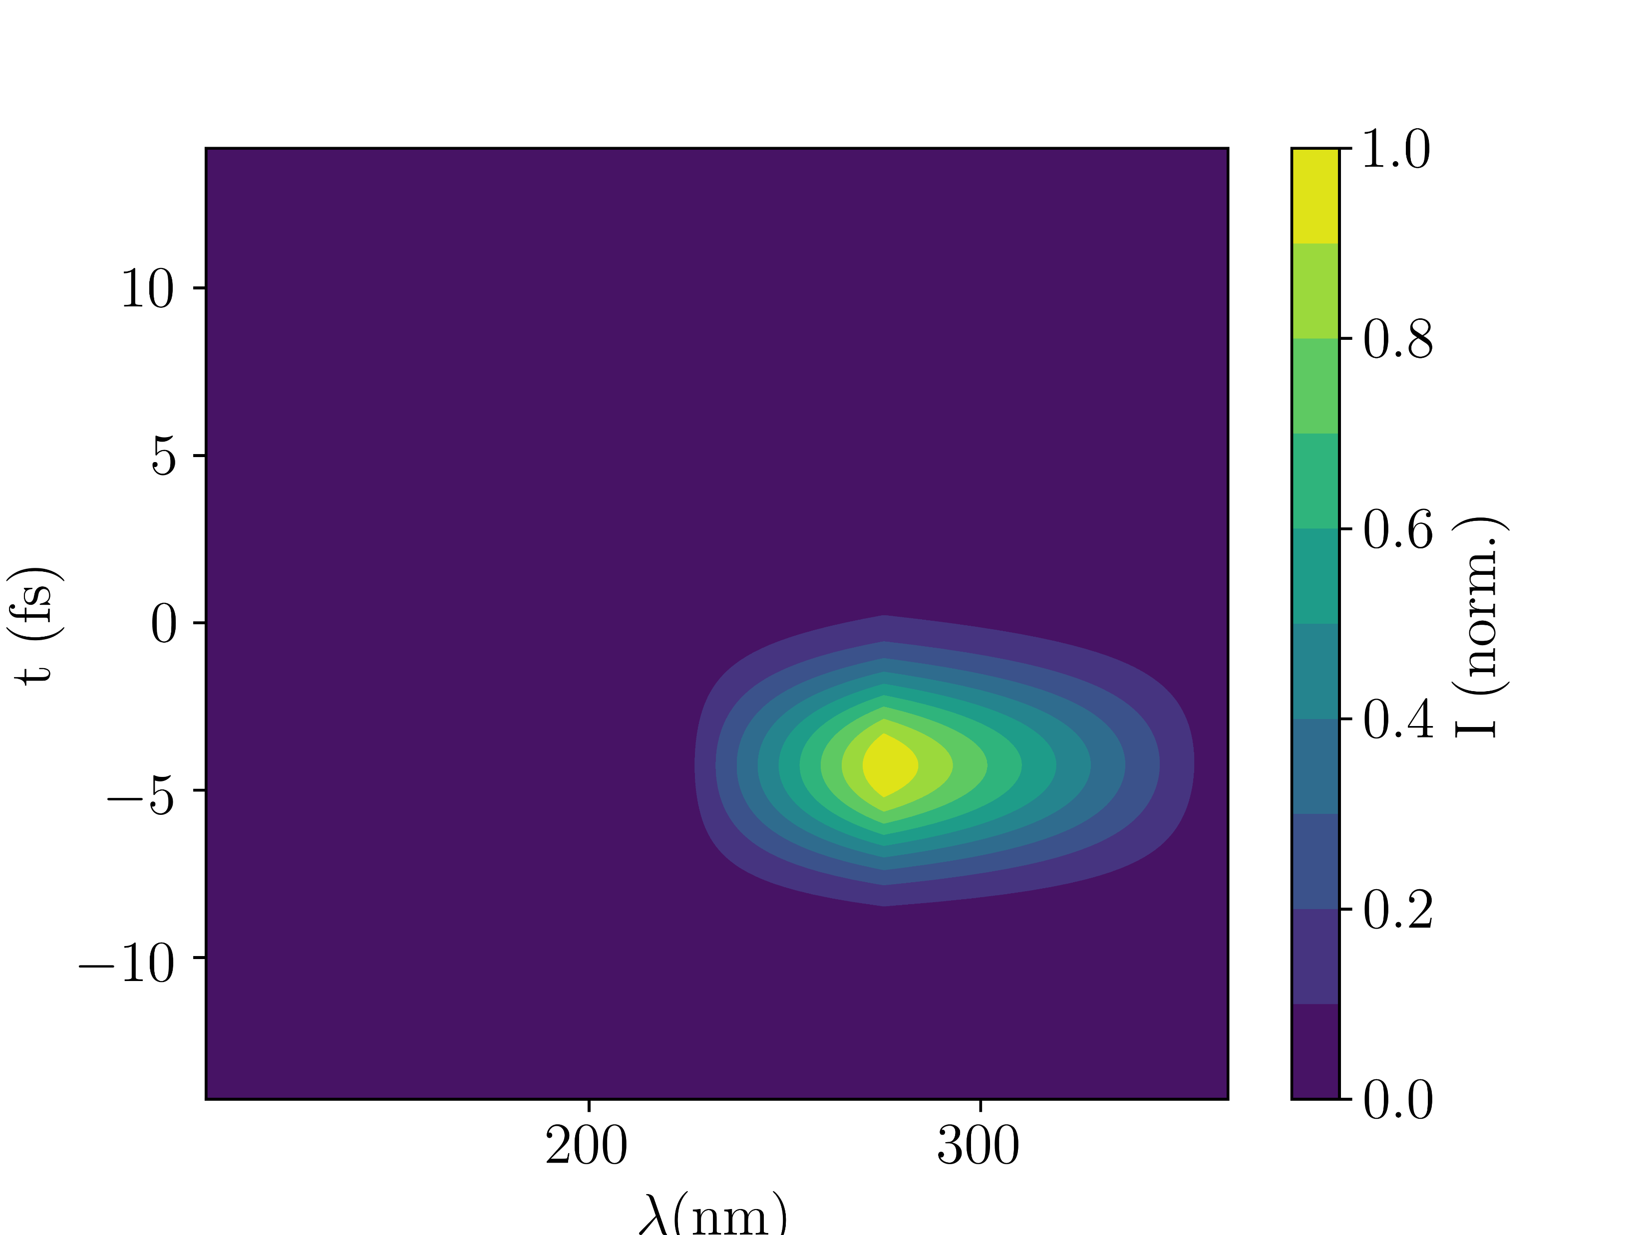
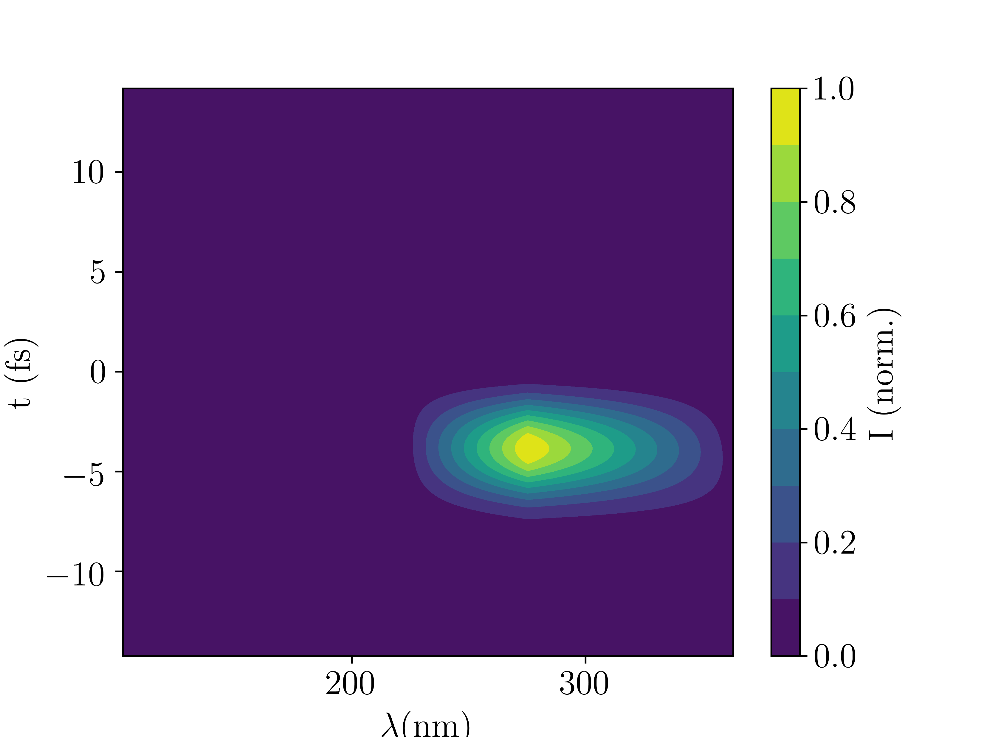
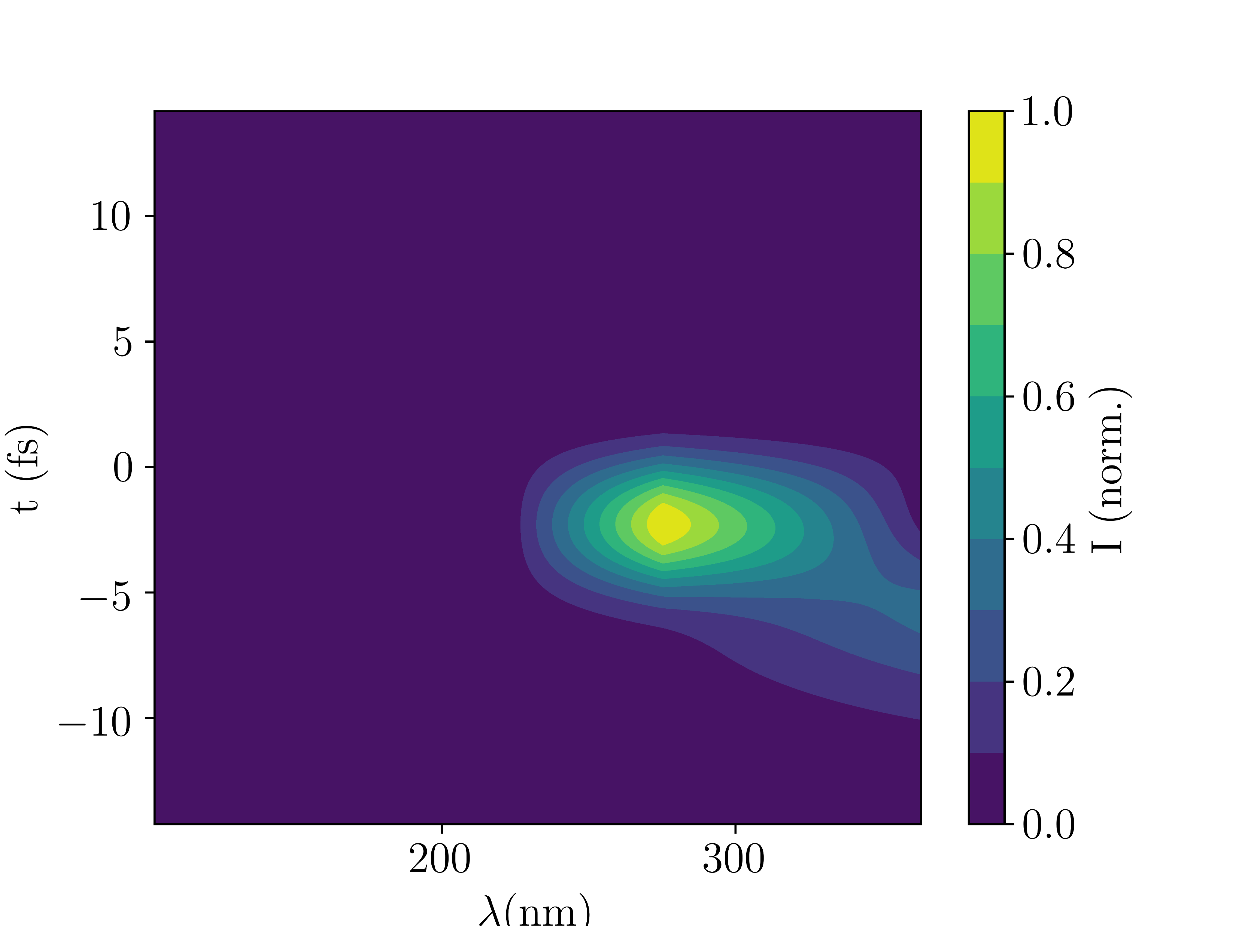
Spectrally-resolved time profile
GVD=-11fs^2
GVD=0
GVD=+11fs^2
Argon; 0.4bar (rescaled); 150mW

Slide 5
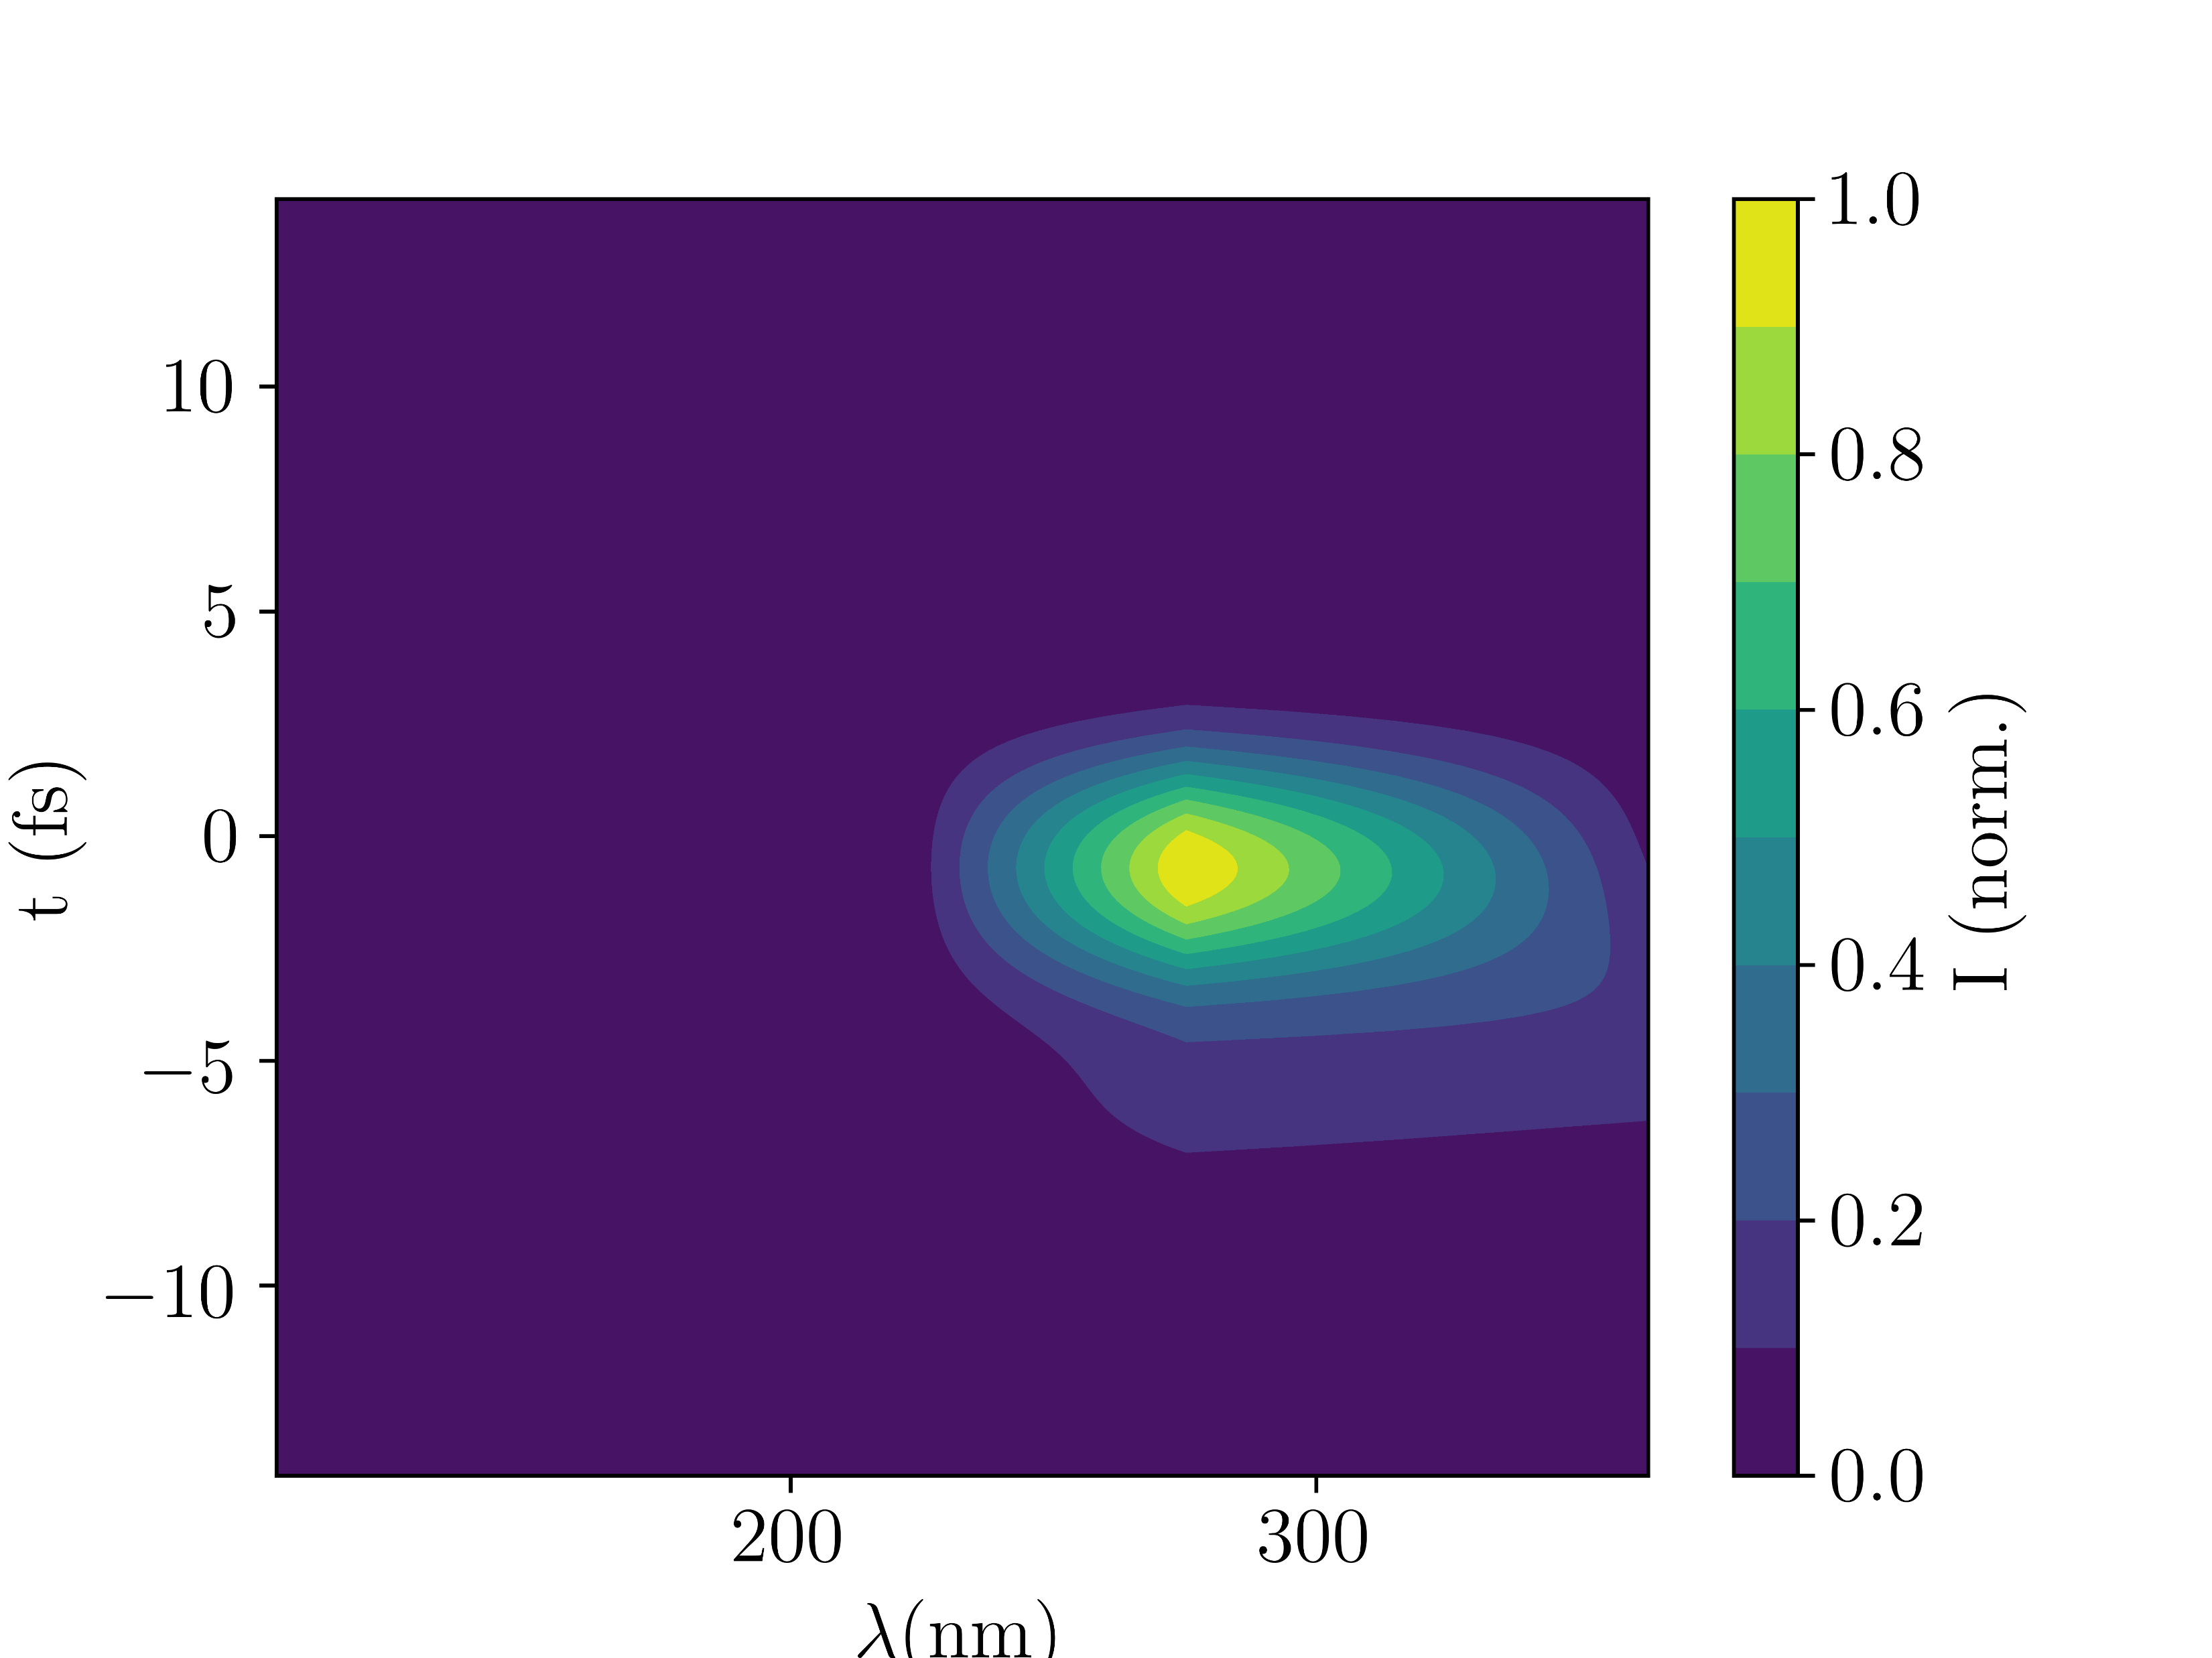
Spectrally-resolved time profile
ionisation
no ionisation
Argon; 0.4bar (rescaled); 150mW

Slide 6
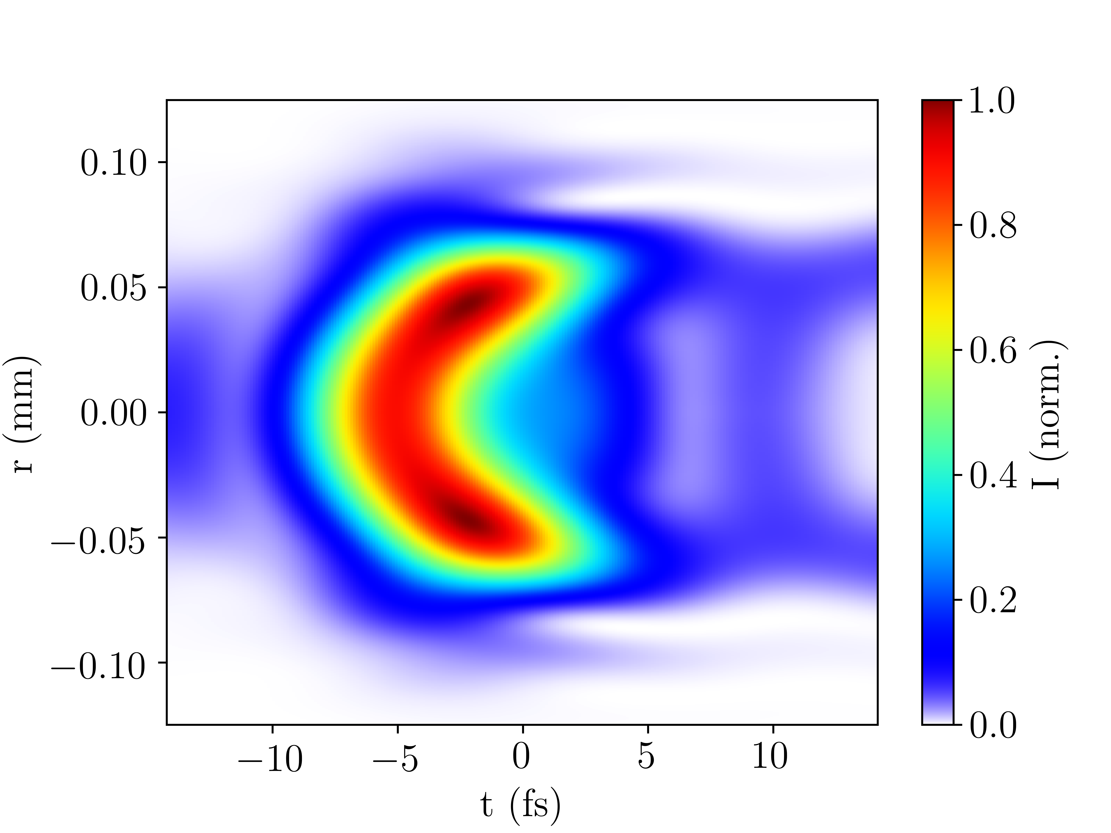
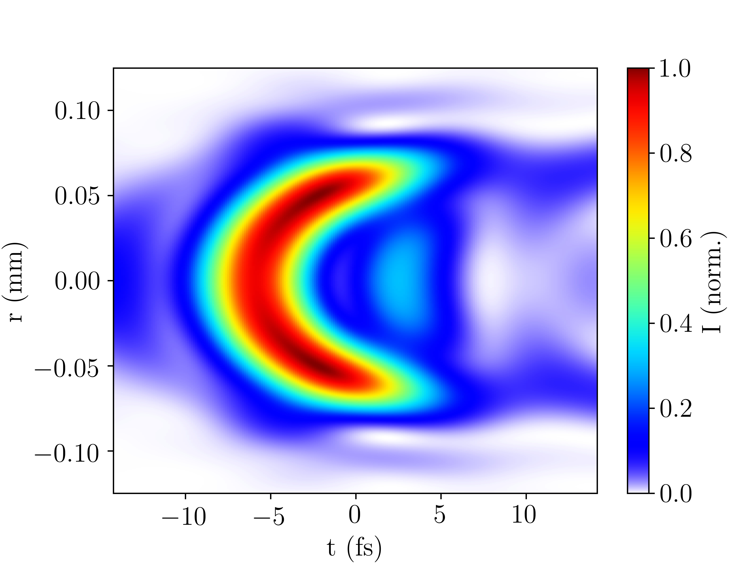
Neon self-defocusing
1.0 bar
6.0 bar
Neon; rescaled pressures; 400mW

Slide 7
Admin
Submitted report
Final meeting with Francesca today
Will return access cards and transducer to Patricia on Thursday
IT access should be retained until 30 September (?), can use my university’s cluster to run the simulations if not

